Slide 1
Weathering and Erosion

Slide 2
Objective: Investigate how weathering and erosion changes the Earth.

Slide 3
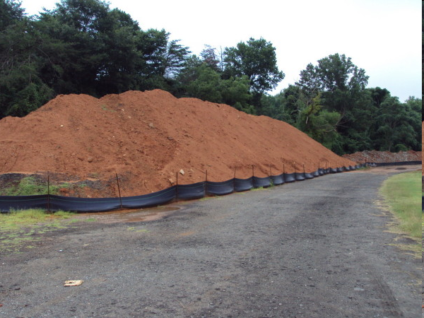
Have you ever had a mound of dirt in your yard?
What happens overtime?

Slide 4
Weathering
Weathering is the SLOW wearing away of rock into smaller pieces or sediment.
Sediment is rock fragments and particles that come from the weathering of rock and are carried and deposited by wind, water, or ice.
There are two types of weathering:
  Mechanical weathering
  Chemical weathering

Slide 5
Mechanical Weathering
Mechanical weathering takes place when rocks are broken down without any change in the chemical nature of the rocks.
The rocks are essentially torn apart by physical force, rather than by chemical breakdown.

Slide 6
Mechanical Weathering
Water- rivers, ocean, rain, freezing and thawing
Heat- wildfires, extreme heat
Plants- trees, roots, vines

Slide 7
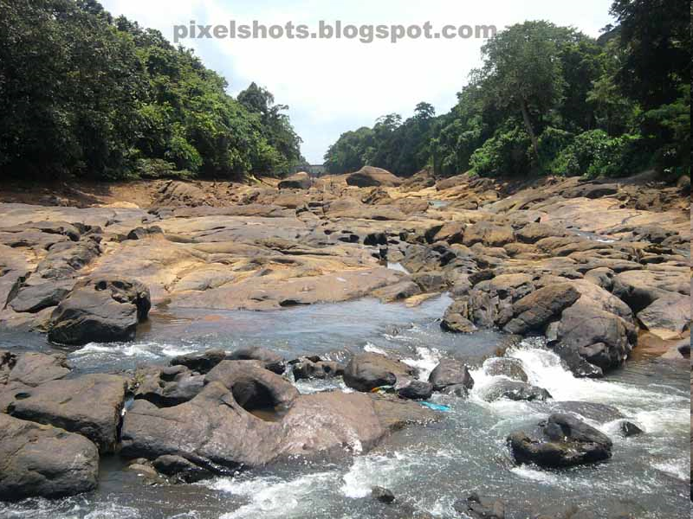

Slide 8
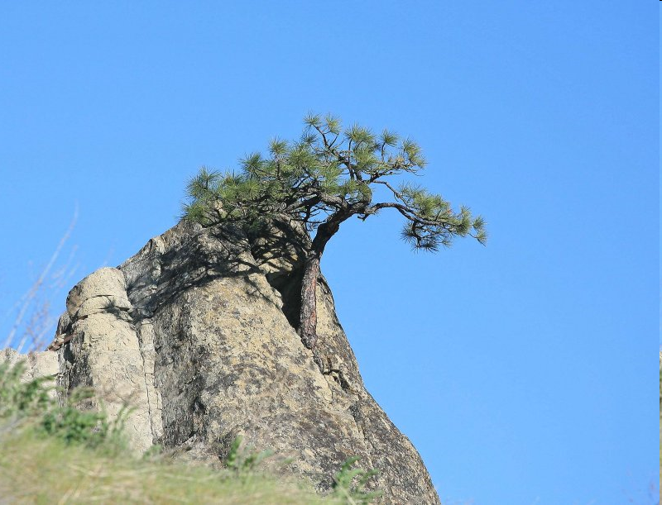

Slide 9
Chemical Weathering
Chemical reactions break down the bonds holding the rocks together, causing them to fall apart, forming smaller and smaller pieces.
Chemical weathering is much more common in locations where there is a lot of water, because water is important to many of the chemical reactions that can take place.
Example; the creation of clay

Slide 10
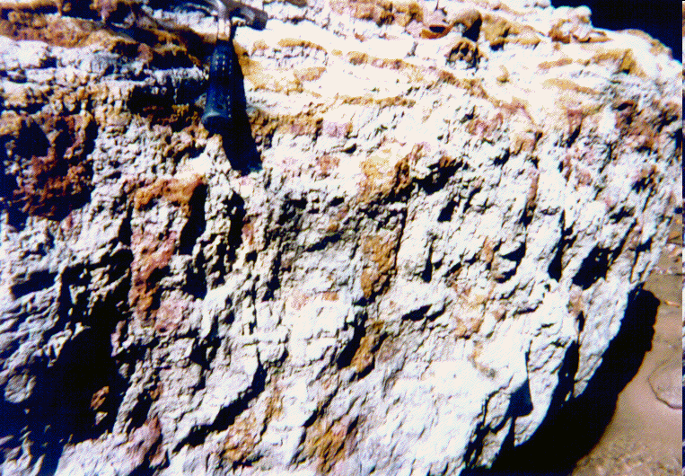
Oxidation: Rocks can rust

Slide 11
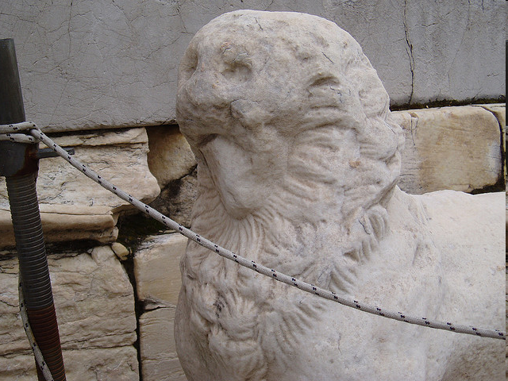
Effects of Acid Rain

Slide 12
Erosion
Erosion is the movement of rock material from ONE PLACE to ANOTHER.
Materials that are the result of weathering are carried away by erosion.
Three main causes of erosion:
Water, wind, and glaciers

Slide 13
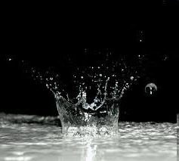
Erosion: Water
Think of a drop of water that splashes on the soil.
The water picks up tiny particles and moves them downhill.
As the water continues,
it picks up more particles
and moves them too.

Slide 14
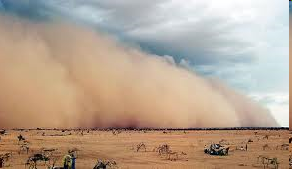
Erosion Wind
Why are plants important for the protection from erosion?
There are some areas of the world that do not have plants to hold down soil.
When the wind blows,
it carries away sand
and soil.

Slide 15
Erosion: Glaciers
Glaciers are larges masses of slow- moving ice.
It move so slowly that we can not see it move.
As it moves, a glacier can dig out huge areas of rock to form deep valleys and canyons.

Slide 16
Deposition
Deposition is the dropping of sediment moved by water, wind, and ice.

Slide 17
Discussion
You have two rocks, one rough and one smooth. Which has been weathered more?
Where would you observe weathering?
Where would you observe erosion?

